Slide 1
SoftSlam Installation Instructions

Slide 2
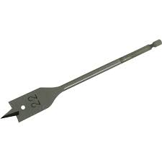
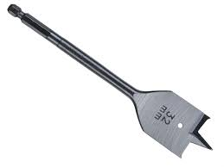
WHAT YOU WILL NEED
22 MIL SPADE BIT
32 MIL SPADE BIT
OR
; AND
22 MIL AUGER BIT
Auger or Spade bit for drilling SoftSlam hole
and
Spade bit for drilling push plate

Slide 3
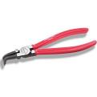
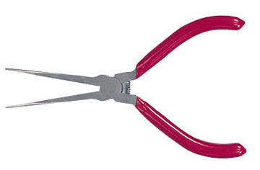
YOU WILL ALSO NEED
OR
OR
OR
CURVED CIRCLIP PLIERS
LONG NOSE PLIERS
CIRCLIP PLIERS
CURVED LONG NOSE PLIERS
AND
ADHESIVE

Slide 4
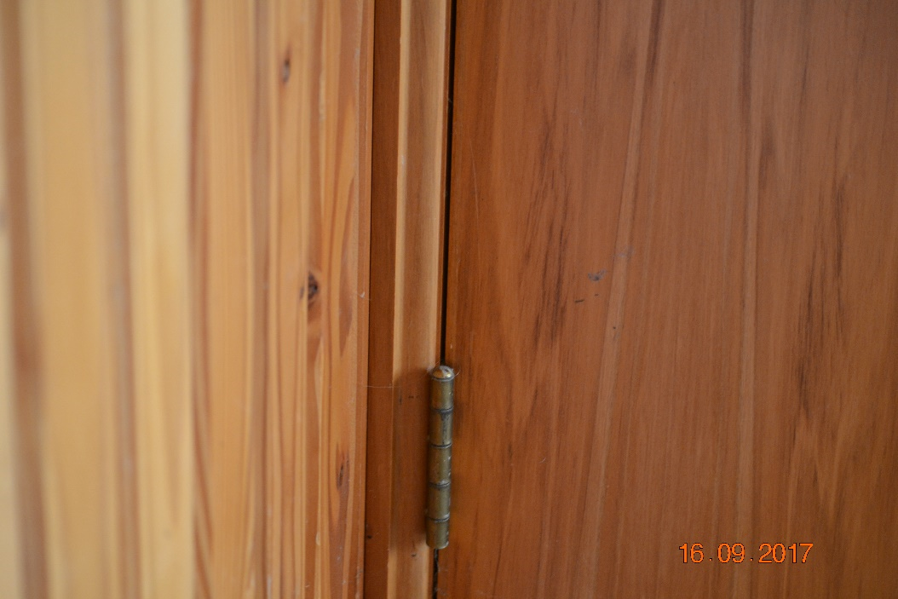
STEP 1 – Get to know your door
Decide if you want your SoftSlam in the jamb or in the door.
* SoftSlam must be fitted to the door only when SlimLine jambs applications.
* SoftSlam can go in the jamb on architrave jamb system, only.
Door Gap
2. Analyse your door gap.
If your door has a standard 3 mil or wider gap, you are ready for STEP 2. Doors comes from the manufacturer with a 3 mm door gap allowing for paint which will give a 2mm gap finish. Use the 32 mm spade bit to allow the 1mm paint allowance. Just take the paint off or allow the 1mm . SoftSlams flange is 3m thickness.
If your door has a narrow gap, using your 32 mil spade bit, carefully create a place to countersink the flange of the SoftSlam at the desired location. Door gaps can be 0 to 6 mm or more. See diagram on the right.
***Note: if the gap is not large enough and this step is skipped, your door can bind on closing.
3 mm

Slide 5
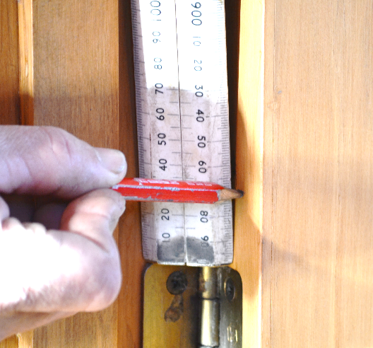
Step 2: Drilling the 22 mil hole
1. Mark the centre point of the door 30 mm above the bottom hinge where you want your SoftSlam.
2 . Using your 22 mm bit, drill at least 105 mm deep at the centre point. Insert the SoftSlam into the hole to verify fit. If it is too tight, use your drill to ease it slightly.
If your door has a narrow gap, using your 32 mil spade bit, carefully create a place to countersink the flange of the SoftSlam at the desired location. Door gaps can be 0 to 6 mm or more. See diagram on the right.
***Note: if the gap is not large enough and this step is skipped, you can cause your door to bind on closing.

Slide 6
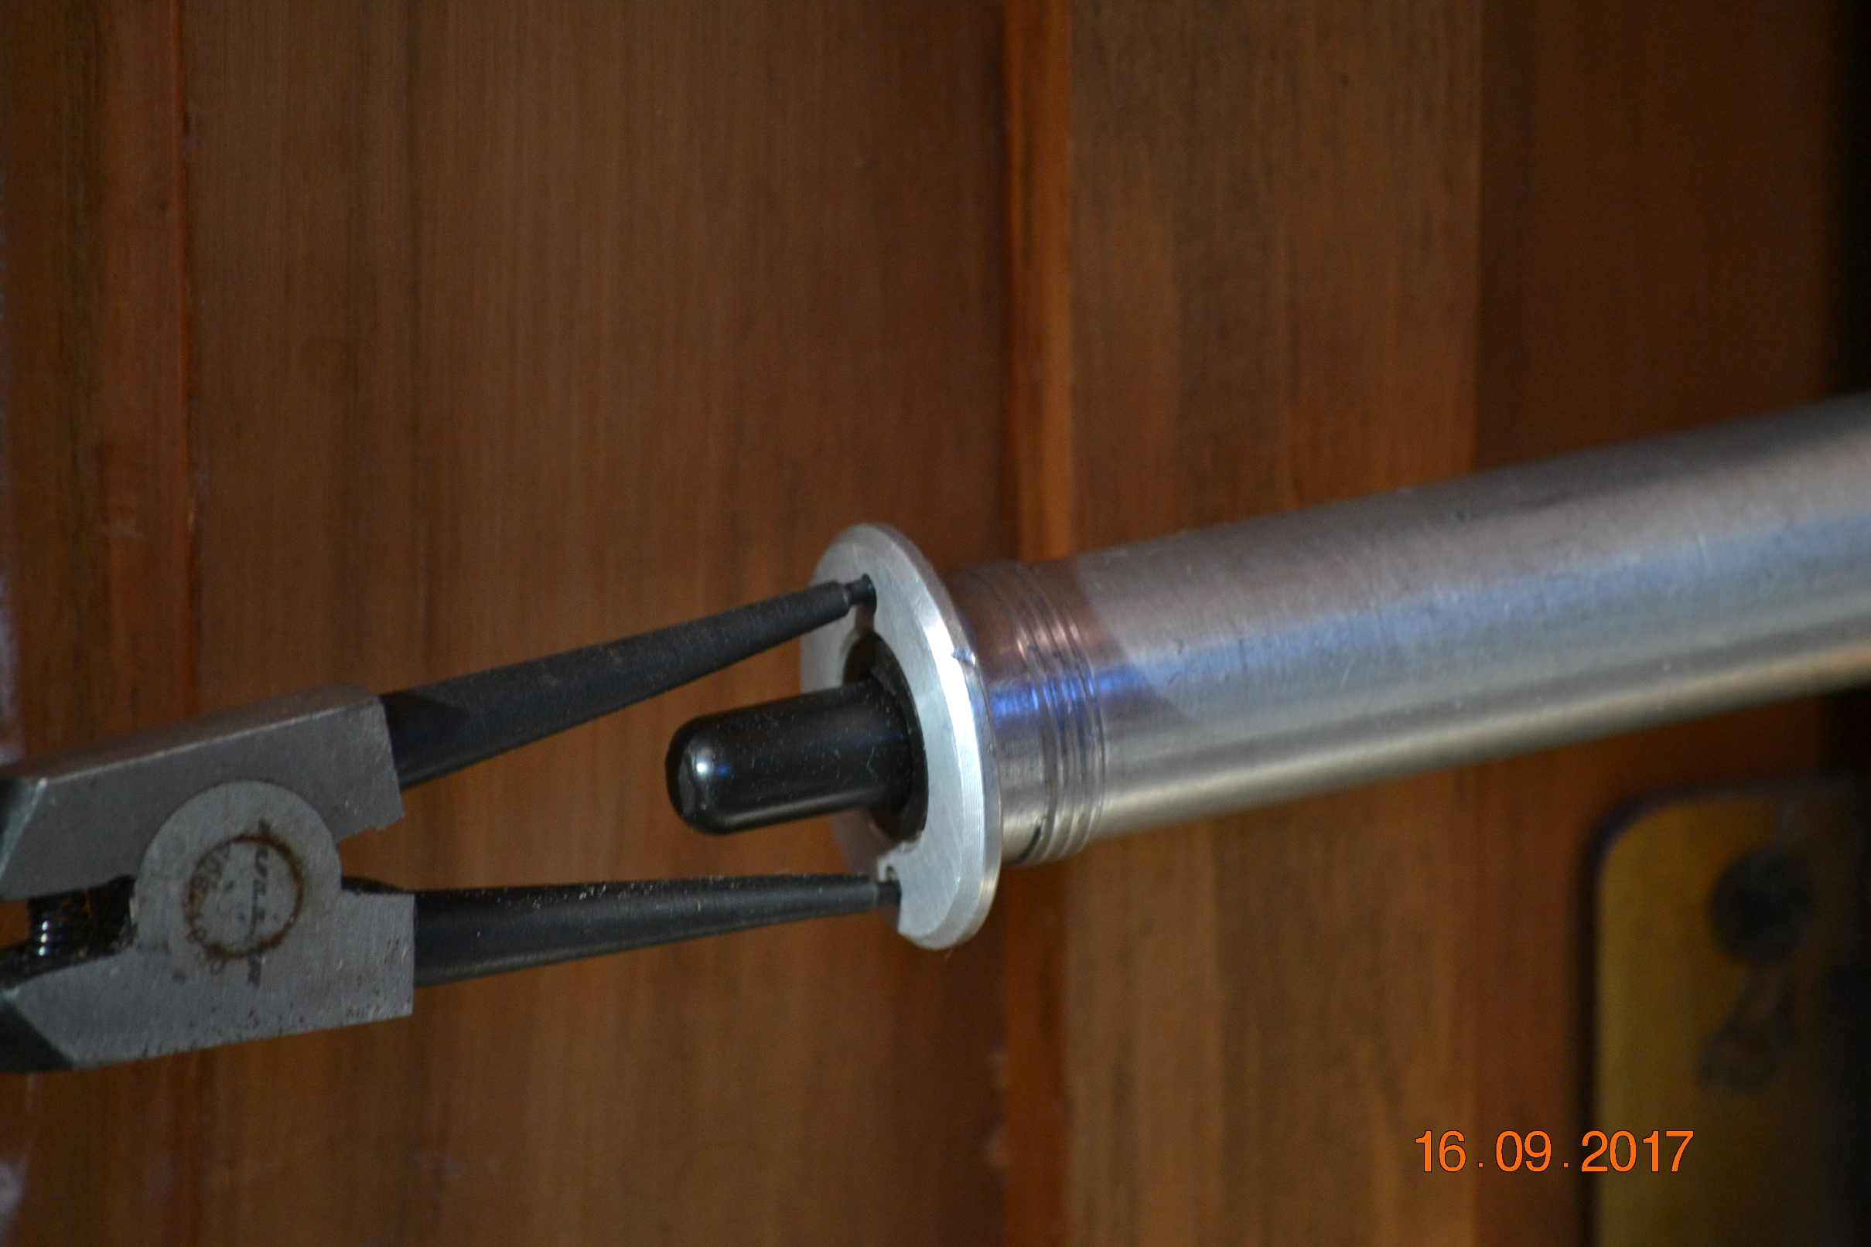
Step 3: Screw the SoftSlam in firmly
Use your needle nose or circlip pliers to screw the SoftSlam in firmly till the Flange is seated for the gap required.
Take your time and you can use a touch of soap or candle to make just like you do with a screw if the screwing is Tight.
Or ease a little more with the drill bit.

Slide 7
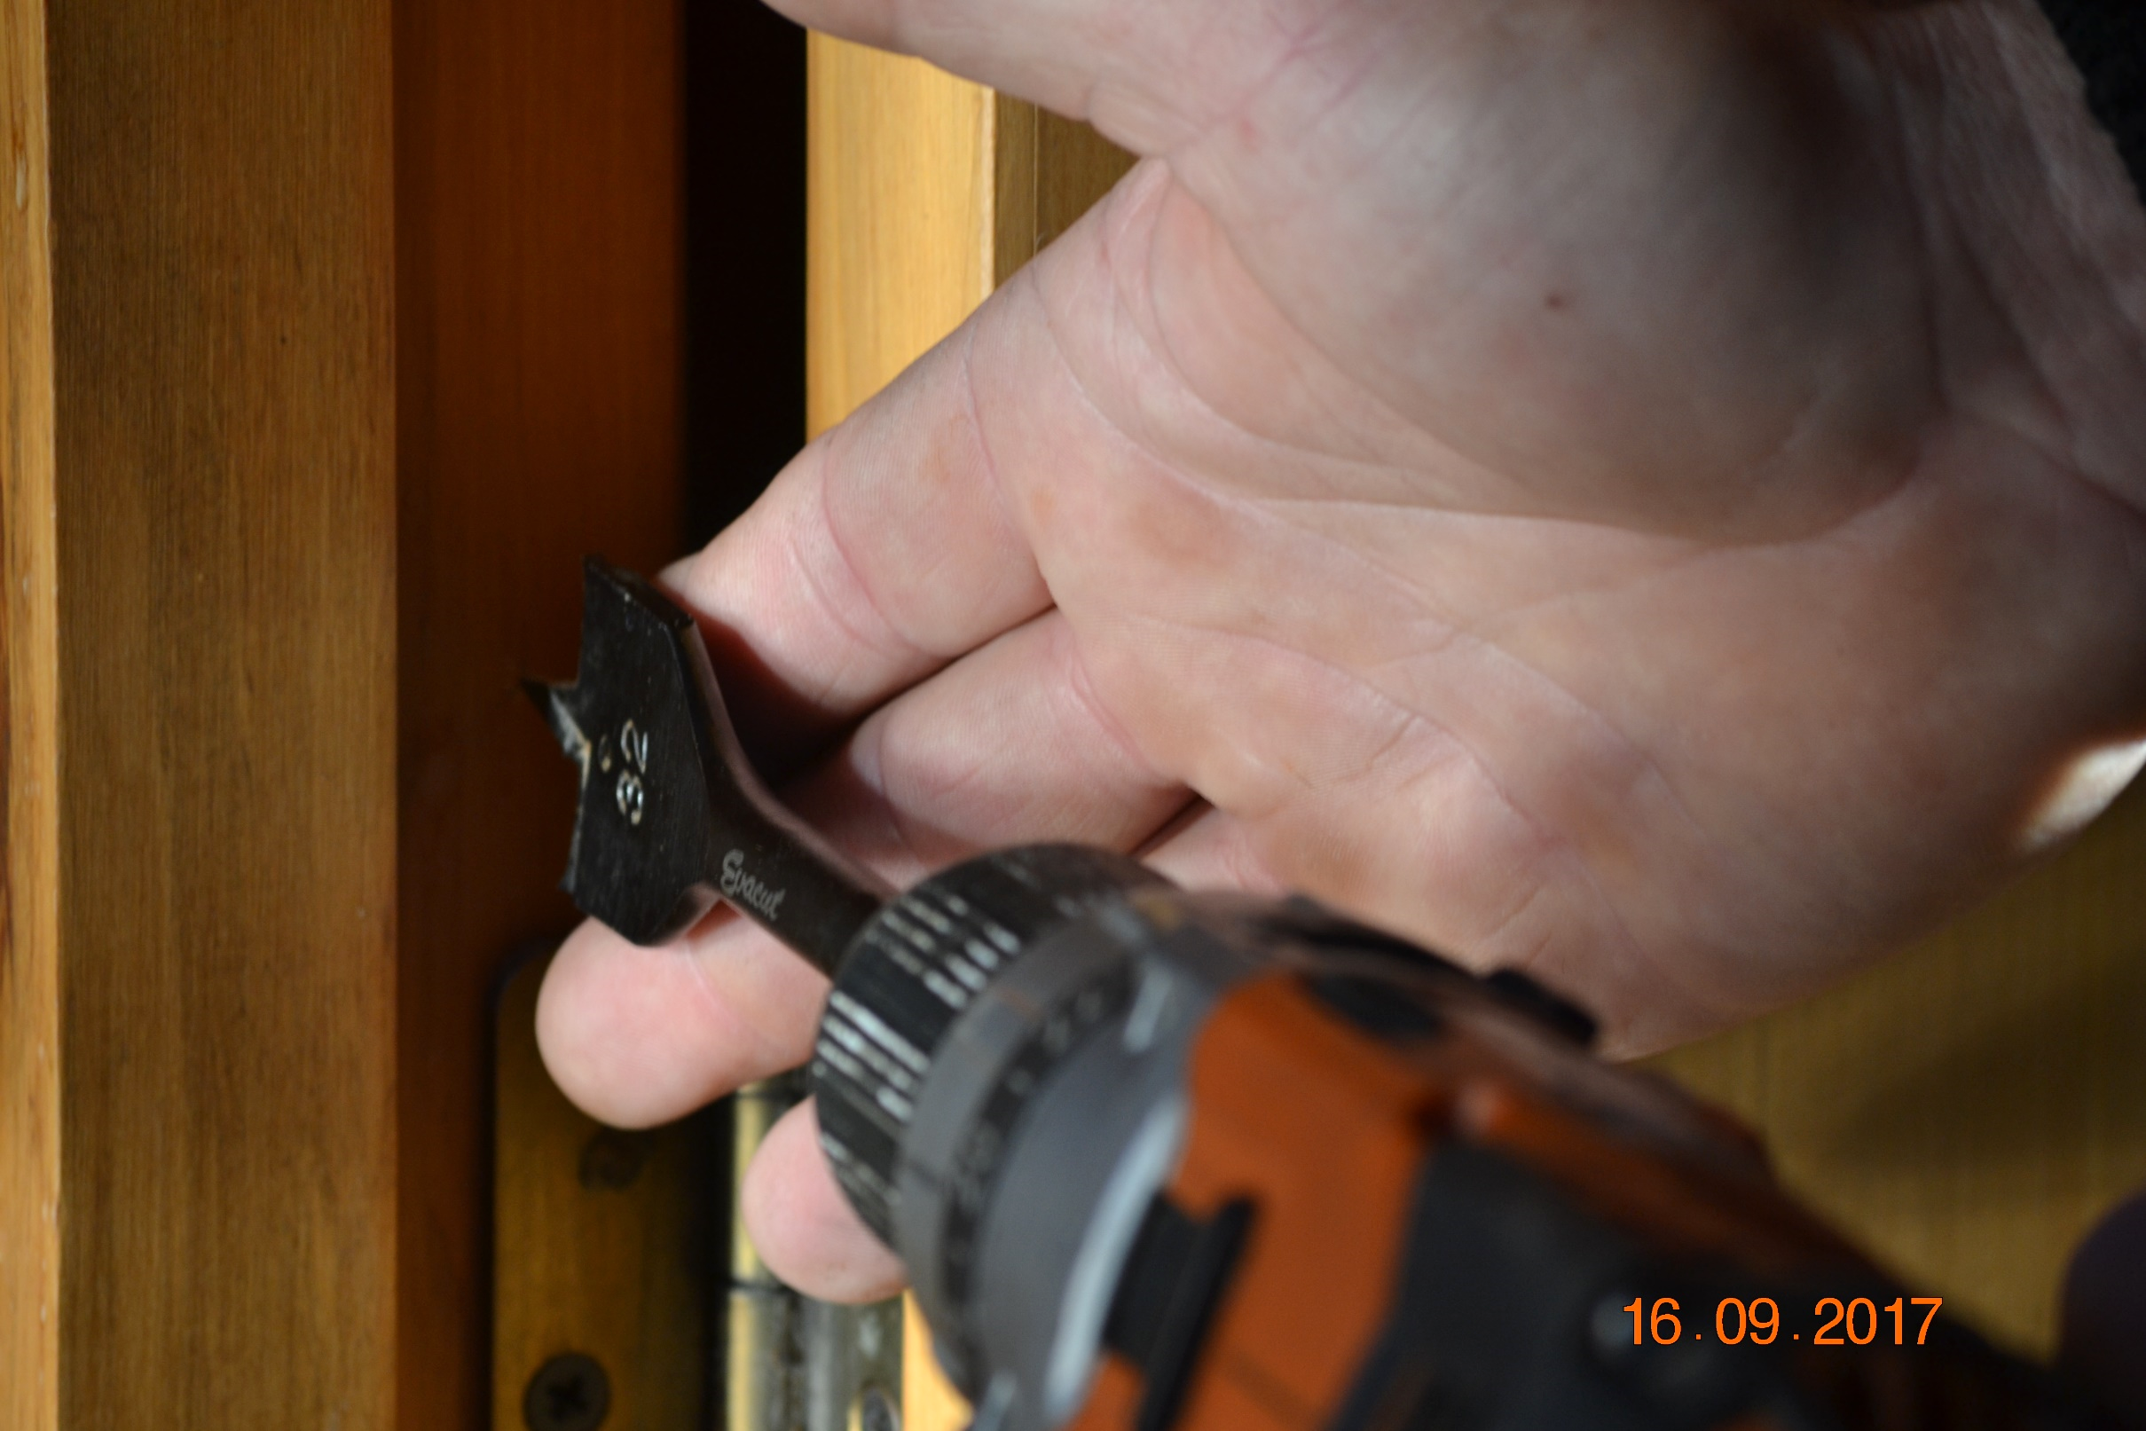
Step 4: Install the Strike Plate
Gently close your door. When you open the door again, there will be an indent from the SoftSlam on the opposite surface. This is the centre point of the strike plate. This gives you an idea where the strike plate will be. Centre the Strike plate to the door or jamb.
Using the 32 mm bit, carefully create a counter sink to set the strike plate in. For a clean finish, you will want the strike plate to sit flush with the surface.
Apply adhesive to the back side of the strike plate.
Insert strike plate into counter sink.
Close door and leave undisturbed until glue sets per the glue manufacturer’s recommendations. Any Construction adhesive for metal and wood will do.

Slide 8
You are now ready to use your SoftSlam
Remember, your SoftSlam has a reset time after every activation. Do not catch a finger in the door while playing with your anti-slamming device. Watch for the reset. Heavy duty has a slightly longer reset than light duty. Reset should not be more than 30 seconds. Contact Slammer-Anti Ltd if you think that your SoftSlam is not working. Send a video or return your SoftSlam, in good condition, for a full refund.
Nicolas Hopkins - Owner
25 Totara Park Rd
Foxton
021 230 2318

